Slide 1

Vajra Linux
Strength and Speed, Made in Bharat!
-By Hrishikesh Sachin Kelkar, 11th C.

Slide 2
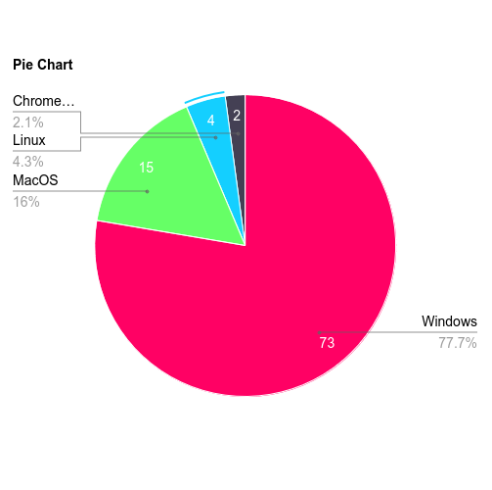
Why Linux?
Currently, market share of Linux is just 4.3%. But it has potential to grow. The Reasons are:
Security: Linux is inherently more secure than Windows and macOS due to its robust permission model and open-source architecture, which allows quick identification and resolution of vulnerabilities.
Cost: Being open-source, Linux is free to use, saving users and organizations significant licensing fees compared to proprietary systems.
Customizability: Linux provides unparalleled flexibility, allowing users to choose from various desktop environments, modify the kernel, and personalize every aspect of the operating system.
Performance on Old Hardware: Linux can run smoothly on minimal resources, making it ideal for reviving older computers and extending their lifespan.

Slide 3
Why Linux For Bharat?
16%
It has exponential potential to grow in Bharat. The awareness about Linux has already started. Linux has gained a massive 16% market share in Bharat, beating the 4.3% average of the world.
Reducing Software Piracy: With software piracy rates high in Bharat, Linux offers a legal, free alternative that eliminates the need for pirated proprietary software.
Support for Bharatiya Languages: Linux distributions like BOSS and Vajra Linux provide extensive support for 10+ Bharatiya languages, promoting inclusivity and accessibility.
Low Resource Requirements: Many households in Bharat use older computers; Linux’s ability to function well on low-spec hardware makes it a practical choice.
Self-Reliance and Open-Source Innovation: Promotes the spirit of "Atmanirbhar Bharat" by reducing dependency on costly foreign software and encouraging local innovation in open-source technology.
4.3%
The World
Bharat
Linux Market Share

Slide 4
Linux vs Windows vs MacOs
Free and open-source
Free and open-source
Feature | Linux | Windows | MacOS
Cost | Free and Open Source | Paid(license cost varies by version) | Paid(bundled with apple devices)
Customizability | Highly Customizable to its core, and the kernel too | Limited to changing themes and UI | Minimal, locked ecosystem
Security | Highly secure, very less malware threats | Frequent target for viruses and malwares | Fewer attacks but some specific vulnarabilities
Hardware Requirements | Lightweight, runs on very old hardware too | Higher requirements, updates slow down the system even more | Required premium apple hardware

Slide 5
Linux vs Windows vs MacOs
Free and open-source
Free and open-source
Feature | Linux | Windows | MacOS
Performance | Best performance due to optimization | Can slow over time without maintenance | Optimized only for apple hardware
Privacy | No user tracking, complete transparency | Significant data collection by default | Less tracking, better than windows but not Linux
Development | Preferred by developers, strong terminal tools | Good for windows-specific development(.NET Framework | Good for iOS/MacOS development
Ecosystem | Open, works across all hardware | Closed but supports many devices | Locked into apple ecosystem

Slide 6
Saving Old Computers and Reducing E-Waste
“One Linux Distro = One Less PC in the Landfill.”
Linux’s ability to run on old hardware:
Minimal requirements for [Vajra Linux] (512MB RAM, Dual-Core CPU).
Impact on e-waste reduction:
Reuse older systems instead of discarding them.
Environmental benefits: Lower carbon footprint.
It also supports households which can’t afford to buy a new/high-spec computer as an old computer can be revived by using Linux.

Slide 7
About Vajra Linux
Name origin: "Vajra" symbolizes strength and speed in Indian culture.
Goal: To create a lightweight, secure OS for Indian users while offering global usability.

Slide 8
Features of Vajra Linux
Lightweight and fast: Perfect for old hardware.
Multi-language support (10+ Indian languages).
Customizable layouts inspired by Windows and macOS.
Preloaded tools for education and development.
Privacy-first approach: Enhanced security.

Slide 9
System Requirements of Vajra Linux
Minimum requirements[Core Edition]:
RAM: 512 MB
Storage: 15GB
CPU: Dual-core
*Approx 8 times less than Windows. Can run on PCs as old as 15 years*

Slide 10
The Three Layouts
Windows 7/10-like: Familiar and easy to transition to.
Windows 11-like: Sleek and modern.
macOS-like: Minimalist and polished.

Slide 11
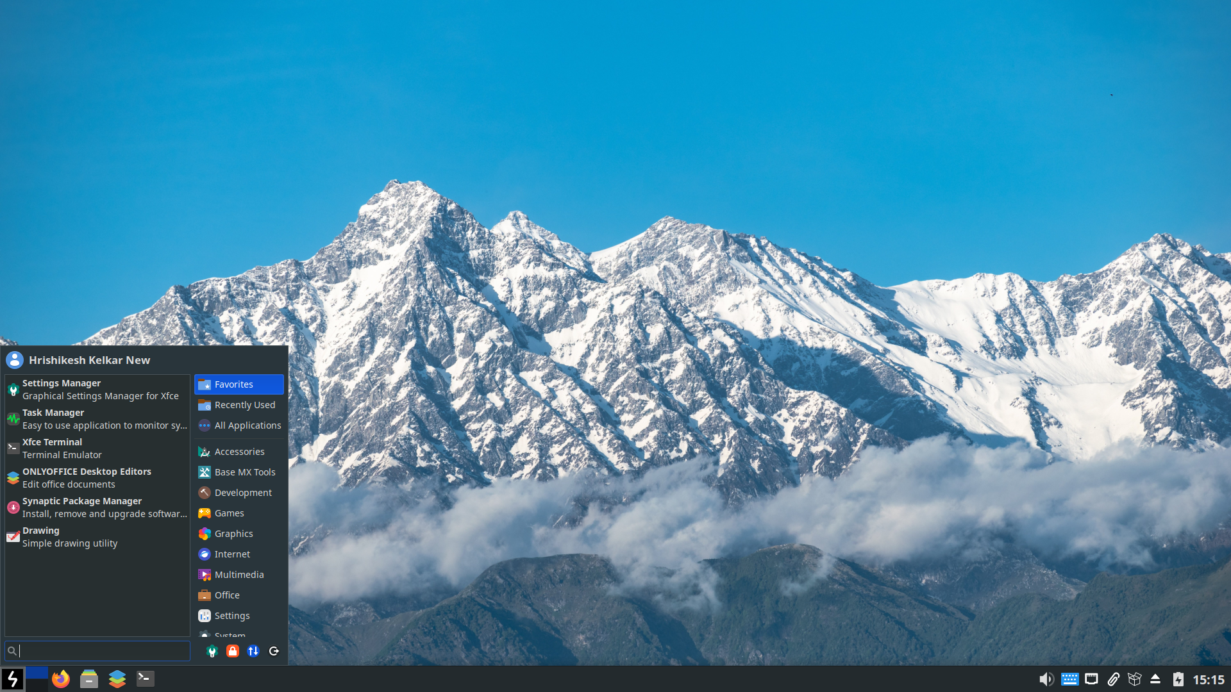
Windows 10 Layout

Slide 12
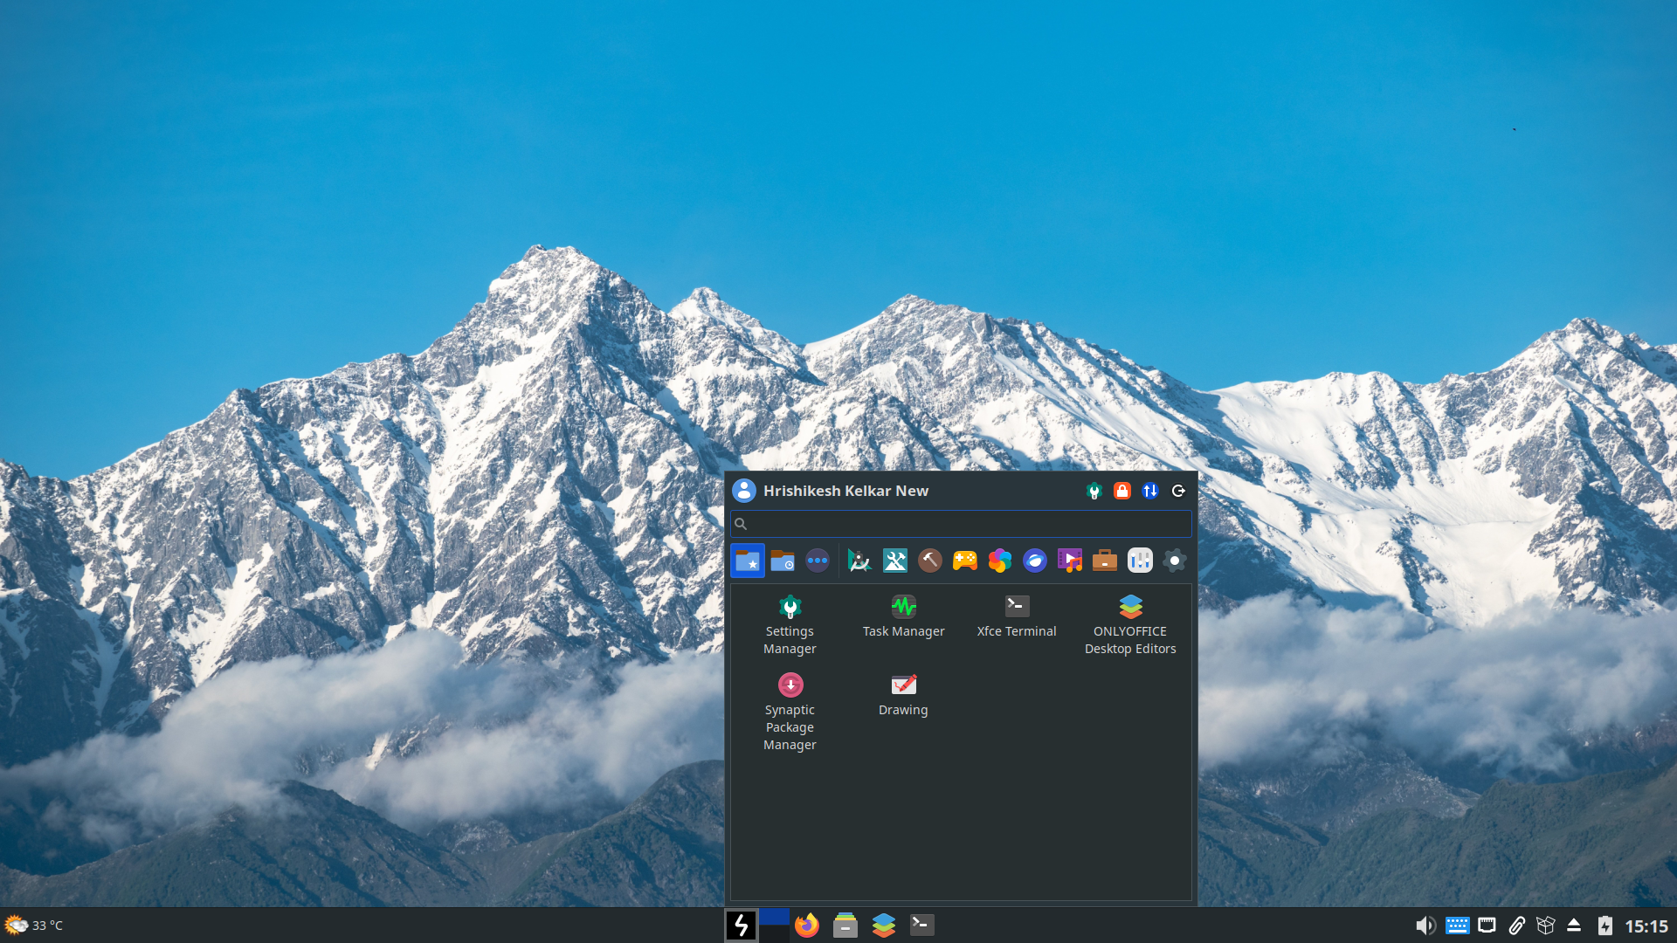
Windows 11 Layout

Slide 13
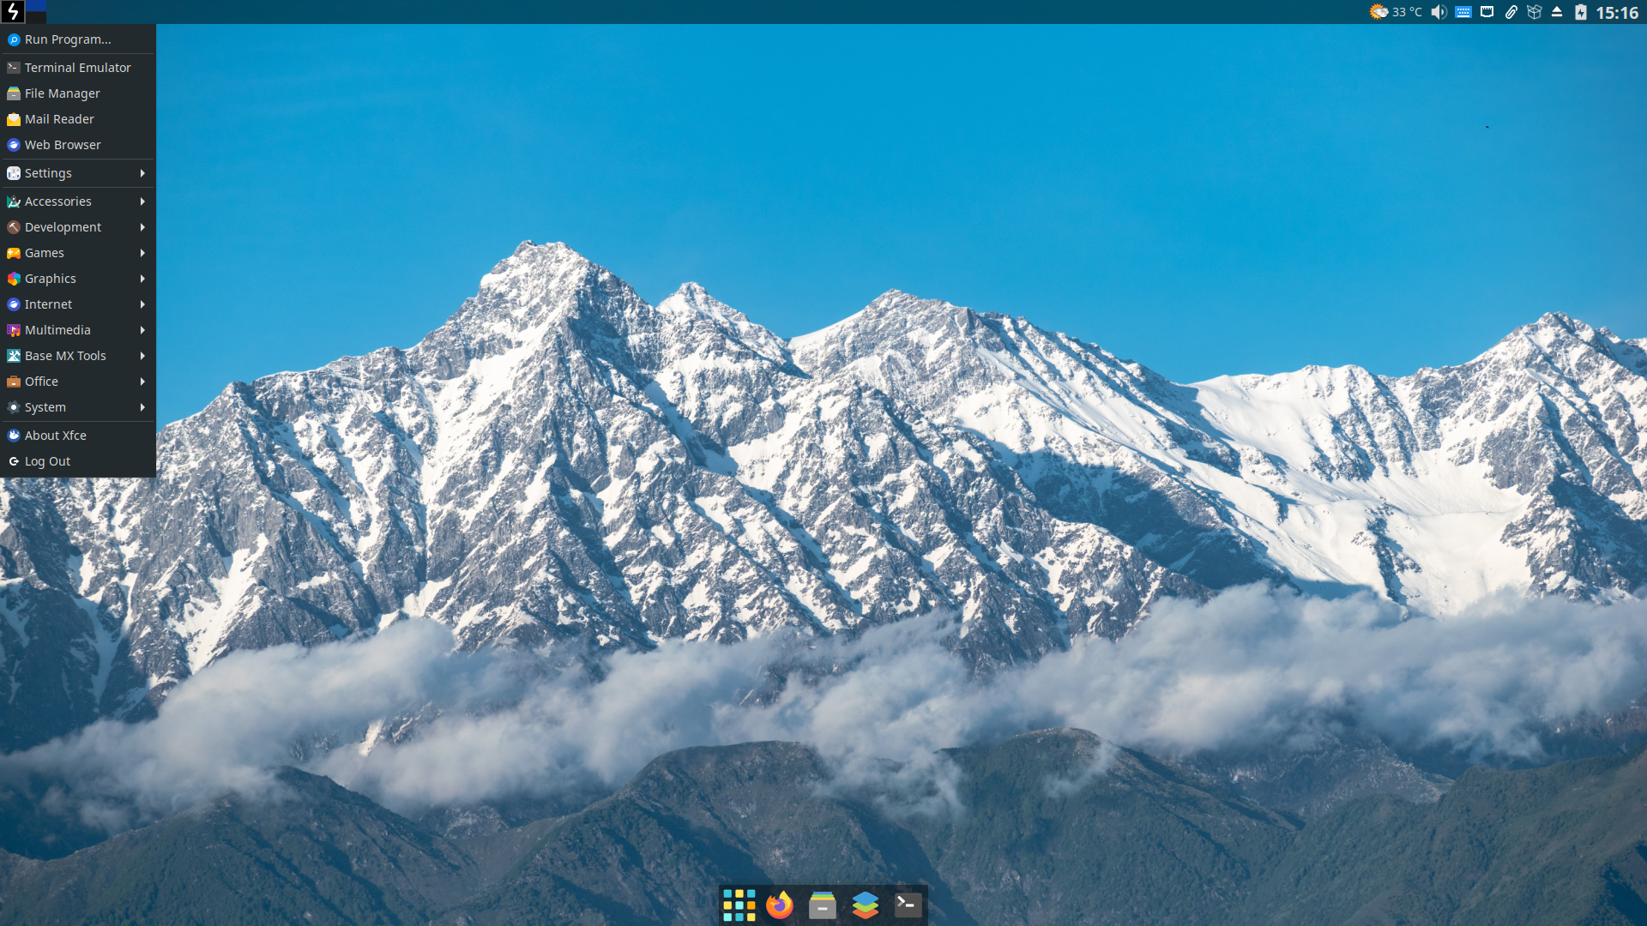
MacOS Layout

Slide 14
The Three Editions
Core Edition: For general-purpose use on older hardware.
Education Edition: Preloaded with educational tools, including offline resources.
Development Edition: Tailored for developers, IT Professionals.

Slide 15
Core Edition
Lightweight and fast, designed for everyday tasks and older hardware.
Preloaded with essential apps for web browsing, multimedia, and productivity.
Minimal system requirements: 512MB RAM and a dual-core processor.
Ideal for personal use and users transitioning to Linux.

Slide 16
Education Edition
Includes tools like GeoGebra, Scratch, Avogadro, etc. for interactive learning.
Preloaded with LibreOffice and Calibre for academic and productivity needs.
Supports more than 10 Indian languages for accessibility in diverse classrooms.
Perfect for students, teachers, and institutions focusing on e-learning.

Slide 17
Development Edition
Equipped with developer tools like GCC, Python, Rust, and Node.js.
Preinstalled IDEs such as Gedit, Jupyter-Notebook, and Code::Blocks for seamless coding.
Includes version control tools like Git and Docker for collaborative projects.
Designed for programmers, cybersecurity enthusiasts, and tech professionals.

Slide 18
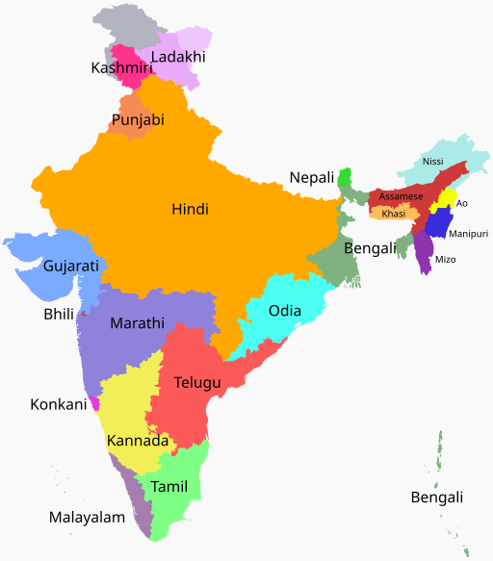
Indian Language Support
Supports more than 10 Indian languages.
Easy system and keyboard language switching.

Slide 19
Credits:
Website: Nikhil Pethe
Community Contributions: Members of ItsFOSS Community
Neville Jackson
Paul
Ihasama
Laura Michaels
Xander H
Skywalker

Slide 20
Practical Demonstration

Slide 21
Thank You!
Jai Hind!

